Slide 1
PROJECT ON CREDIT RISK
50
10
100
Sales
50
10
100
Marketing Efforts

Slide 2
Project Timeline
Oct
Oct
Nov
Dec
Project kick- off
EDA and building models
Finalizing the best model
Automation and Project presentation
Understanding the business problem
Understanding the data structure, business rules
Analytical dataset preparation
Finalizing EDA results
Model building
Model evaluation and validation
Discussion with mentors for getting doubts clarified
Mid-term project vivas
Model finalization
Discussion with mentors to get the codes finalized
Automating the finalized model
Initial draft of presentation
Finalizing the presentation
Building dynamic dashboard for showcasing automated results
Discussion with mentor for finalizing the presentation and dashboard

Slide 3
Agenda
Understanding Business Requirement
Data collation and cleaning
Data Exploration and Analysis
Data Modeling and Validation
Deployment and Optimization

Slide 4
Business Problem
A group of customers were given an offer in person that they can get a loan at discounted rate and processing fee will be waived off. A pilot campaign was conducted to get response from customers whether they are interested in taking out a loan or not. Response was recorded and data was collected. Based on data given we had to
Build a model to predict whether customers will be interested in taking out a loan or no
In case of black box models e.g. Random forest use SHAP, LIME to figure out features affecting the target variable
Find the profitable segments so that more customized marketing can be done (considering approaching a customer has costs involved)
Model will be needed on a monthly basis as this data gets updated each month
Identify features which are most important

Slide 5
Variables Involved
Balance
Gender
Age
Occupation
No. of credit transactions
SCR
Target
Holding Period

Slide 6
Understanding the challenge faced by the banking industry
50
10
100
Marketing Efforts
50
10
100
Sales

Slide 7
Banking – Traditional Methods
Gut instinct to define ‘best customers’
Determining whether they fit into the eligibility criteria
Conducting Sales calls
Negotiating and follow-up
Closure
Reaching out to a random database of customers is not an efficient means for lead conversion

Slide 8
What’s the best approach for a bank to embark on this journey?
Data Analytics
Analytics will provide banks with more marketing muscle. By using data analytics and data modeling we will be able to filter down the right set of customers that we need to target, and this can in turn help the bank in deploying their resources and increase the lead conversion
50
50
25
75
25
75
10
100
10
100

Slide 9
Understanding data through Exploratory Data Analysis
DATA ANALYSIS

Slide 10
All about the Data – Original Dataset
A
No. of rows
The original dataset had 20,000 rows
B
No. of columns
The original dataset had 8 columns
Data Types
C
All the variables involved the original dataset were integers except Gender and Occupation which were stored as Objects
D
Null Values
There were no Null values in the original dataset

Slide 11
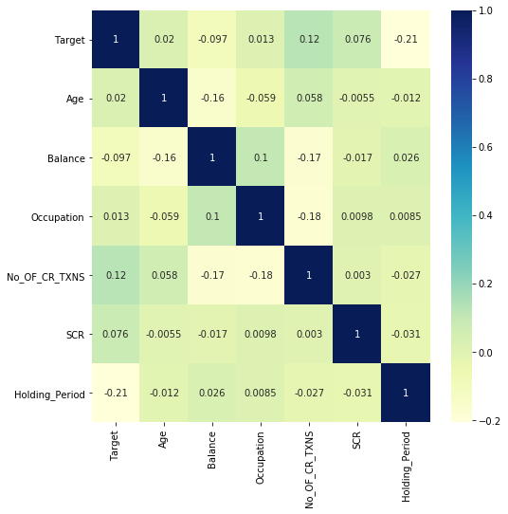
All about the Data – Original Dataset
Understanding how the variables in the dataset interact with each other is crucial when deciding which features to use in a model that is effective and accurate. One of the fastest ways to identify and reduce the features in the dataset that are highly correlated.
Correlated features will add noise and inaccuracy to a model, which will in turn make it harder to achieve the desired output.
NO STRONG CORRELATION IS SEEN OVERALL BETWEEN THE VARIABLES

Slide 12
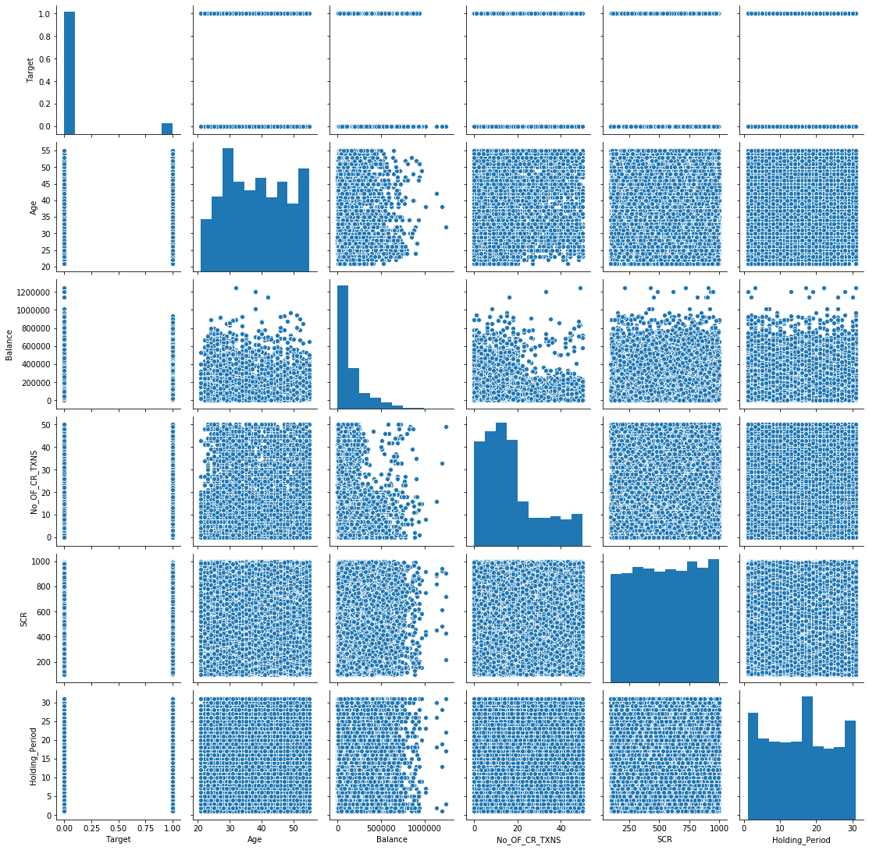
All about the Data – Original Dataset
Pair Plots plot pairwise relationship in a dataset by creating a grid of Axes such that each numeric variable in data will be shared across the Y-Axis across a single row and the X-Axis across a single column.
Pair plot allows us to see both the distribution of single variables and relationships between two variables
The pair plots builds on two basic figures – the histogram and the scatter plot
NO STRONG CORRELATION IS SEEN OVERALL BETWEEN THE VARIABLES. HOWEVER, A MILD CORRELATION CAN BE SEEN BETWEEN HOLDING PERIOD AND OTHER VARIABLES

Slide 13
All about the Data – Data Cleaning
01
196 rows with Gender ‘O’
Values removed while cleaning the dataset
Values removed from dataset which originally had 20,000 rows and 8 columns
8 rows with outlier values (balance > 12,00,000)
02

Slide 14
All about the Data – Cleaned Dataset
Occupation
SCR
Age
Balance
Target
No. of credit transactions
Holding Period
Gender
Data Type | Integer | Integer | Object | Float | Object | Integer | Integer | Integer
Null Values | Nil | Nil | Nil | Nil | Nil | Nil | Nil | Nil
Count | 19796 | 19796 | NA | 19796 | NA | 19796 | 19796 | 19796
Mean | 00.08 | 38.38 | NA | 01.46 | NA | 16.55 | 557.07 | 15.34
Std | 00.28 | 09.59 | NA | 01.68 | NA | 12.92 | 260.55 | 08.95
Min | 00.00 | 21.00 | NA | 00.00 | NA | 00.00 | 100.00 | 01.00
Max | 01.00 | 55.00 | NA | 01.14 | NA | 50.00 | 999.00 | 31.00

Slide 15
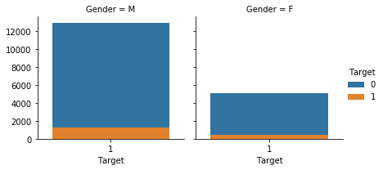
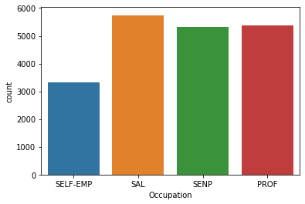
All about the Data – Cleaned Dataset
C
C
No. of rows removed
Total no. of rows
C
Total no. of columns
C
Total no. of null values
19,796
8
Nil
204
C
Customers by Gender and Target
C
Customers by Occupation

Slide 16
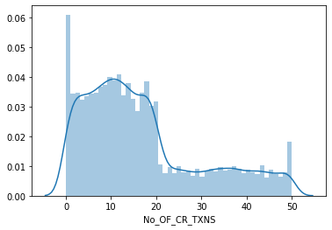
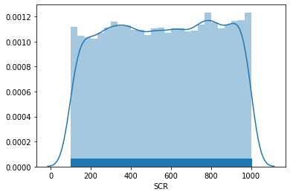
All about the Data – Cleaned Dataset
C
C
No. of rows removed
Total no. of rows
C
Total no. of columns
C
Total no. of null values
19,796
8
Nil
204
C
Customers by No. of Credit Transactions
C
Customers by SCR

Slide 17
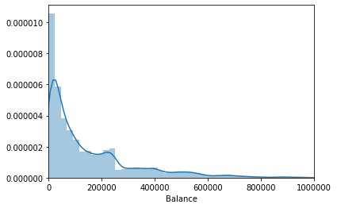
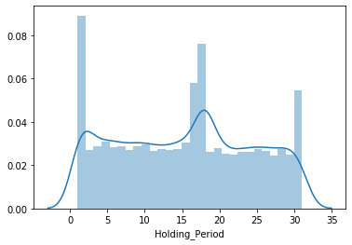
All about the Data – Cleaned Dataset
C
C
No. of rows removed
Total no. of rows
C
Total no. of columns
C
Total no. of null values
19,796
8
Nil
204
C
Customers by Balance
C
Customers by Holding Period

Slide 18
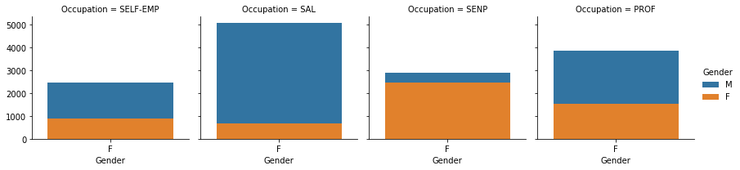
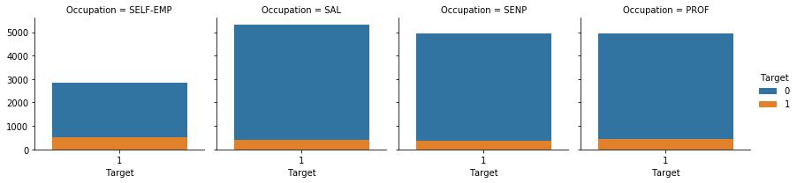
All about the Data – Cleaned Dataset
C
C
No. of rows removed
Total no. of rows
C
Total no. of columns
C
Total no. of null values
19,796
8
Nil
204
C
Customers by Gender and Occupation
C
Customers by Occupation and Target

Slide 19
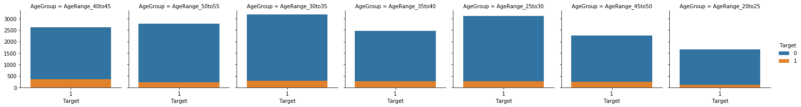
All about the Data – Cleaned Dataset
C
C
No. of rows removed
Total no. of rows
C
Total no. of columns
C
Total no. of null values
19,796
8
Nil
204
C
Customers by Age Group and Target

Slide 20
Data Modeling and Interpretable Machine Learning

Slide 21
Development and Interpretation of ML Models
01
Decision Tree
02
Logistic Regression
03
Random Forest
04
KNN
05
SVM
06
CatBoost

Slide 22
Development and Interpretation of ML Models
Identification of the important features based on all the models, LIME, SHAP and Permutation Feature Importance
Finalizing the best fit model
Identification of profitable segment using KS Chart, Gain Chart and Lift Chart in probability distribution

Slide 23
Preparing data for modelling
Creating Unbalanced Data
Creating Dummies
Creating under sampled data
Creating oversampled data
Creating Extremely Over Sampled Dataset

Slide 24

Decision Tree

Slide 25
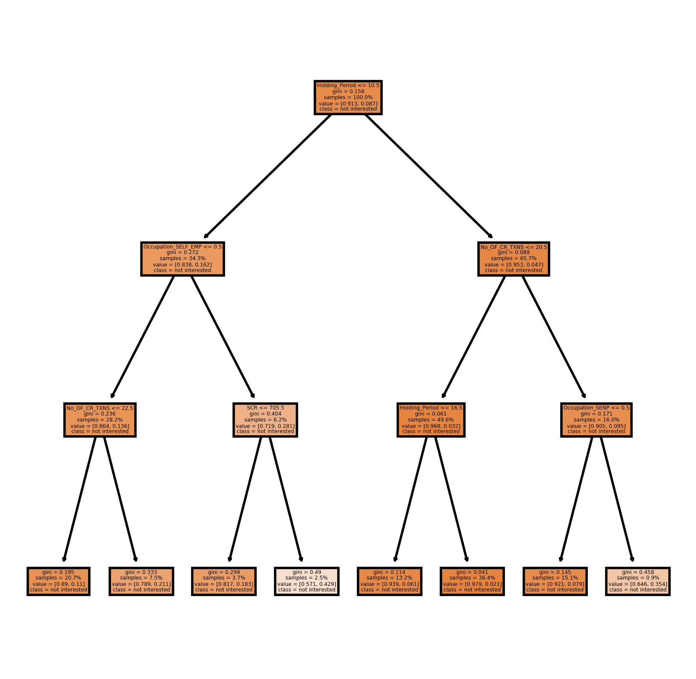
Decision Tree
DECISION TREE - CONCEPT
A decision tree is a flowchart-like structure in which each internal node represents a test on a feature, each leaf node represents a class label (decision taken after computing all features) and branches represent conjunctions of features that lead to those class labels. The paths from root to leaf represent classification rules.
Decision trees are constructed via an algorithmic approach that identifies ways to split a data set based on different conditions. It is one of the most widely used and practical methods for supervised learning

Slide 26
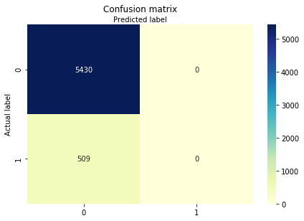
Evaluating Decision Tree
CONFUSION MATRIX - CONCEPT
A confusion matrix is a technique for summarizing the performance of a classification algorithm.
Calculating a confusion matrix can give you a better idea of what your classification model is getting right and what types of errors it is making.
CONCLUSION
The confusion matrix on the left gives us the numeric breakdown of all true/false positive/negatives in the testing data.

Slide 27
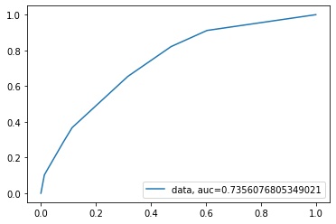
Evaluating Decision Tree
AREA UNDER CURVE - CONCEPT
AUC means Area Under Curve where you can calculate the area under various curves.
The AUC value can be used as an evaluation metric, especially when there is imbalanced dataset.
CONCLUSION
The AUC for Decision Tree is calculated at 73.56%

Slide 28
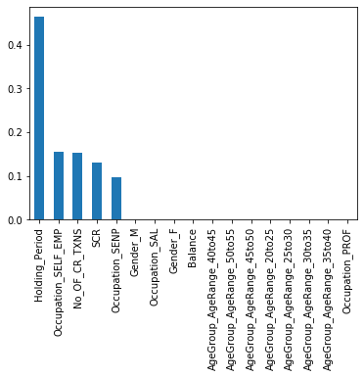
Feature Importance – Decision Tree
FEATURE IMPORTANCE - CONCEPT
Feature importance refers to techniques that assign a score to input features and also play an important role in a predictive modeling project, including providing insight into the data and the model, and the basis for feature selection that can improve the efficiency and effectiveness of a predictive model on the business problem.
CONCLUSION
The most important features (Top 5) as shown on left are:
Holding Period
No. of credit transactions
SCR
Occupation – SELF EMP
Occupation – SENP

Slide 29
Logistic Regression

Slide 30
Logistic Regression
LOGISTIC REGRESSION – CONCEPT
Logistic Regression is a supervised learning classification algorithm used to predict the probability of a target variable. The nature of target or dependent variable is dichotomous, which means there would be only two possible classes.
Logistic Regression is much similar to the Linear Regression except that how they are used. Linear Regression is used for solving Regression problems, whereas Logistic Regression is used for solving the classification problems.

Slide 31
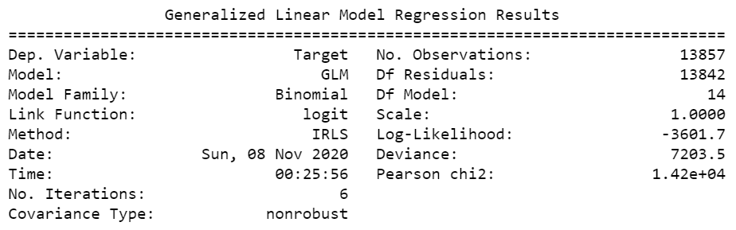
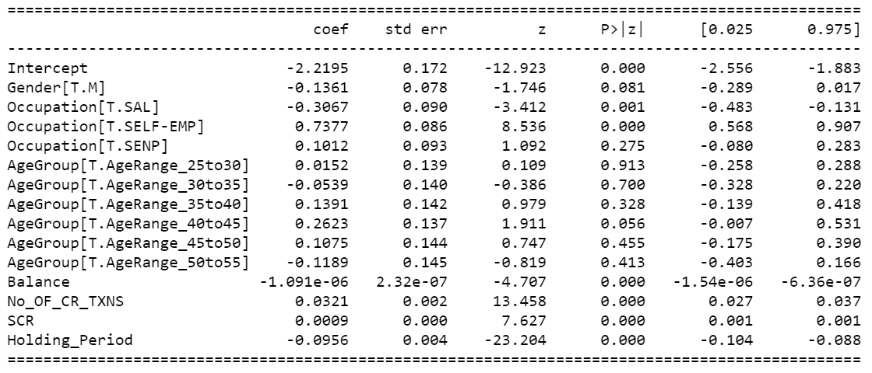
Generalized Linear Model Regression Results
C
OBSERVATIONS
Following variables are having p-value less than 0.05:
Balance
Occupation – SAL
Occupation – SELF EMP
No. of credit transactions
SCR and
Holding Period
These independent variables are having effect on the dependent variable 'Target’.
Thus, we will remove all other variables whose p-value is greater than 0.05

Slide 32
Akaike Information Criterion
AIC - CONCEPT
The Akaike information criterion (AIC) is an estimator of out-of-sample prediction error and thereby relative quality of statistical models for a given set of data. It estimates the relative amount of information lost by a given model: the less information a model loses, the higher the quality of that model.
AIC = -2/N * LL + 2 * k/N Where N is the number of examples in the training dataset, LL is the log-likelihood of the model on the training dataset, and k is the number of parameters in the model.
Given a collection of models for the data, AIC estimates the quality of each model, relative to each of the other models.
Thus, AIC provides a means for model selection. The model with the lowest AIC is selected
MODEL 2
MODEL 1
MODEL 3
AIC
CONCLUSION
The score for Logistic Regression is 7233.47.

Slide 33
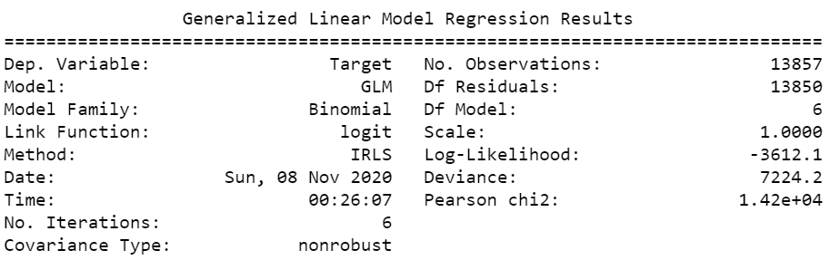
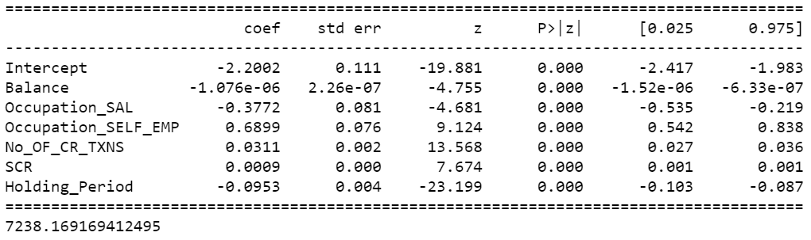
Generalized Linear Model Regression Results
C
OBSERVATIONS
Following independent variables are having p-value less than 0.05 (They are impacting the dependent variable 'Target’):
Balance
Occupation - SAL
Occupation – SELF EMP
No. of credit transactions
SCR and
Holding Period
As per output of the feature importance of Decision tree Classifier, sequence of these independent variables as per their importance are (these independent variables are having effect on the dependent variable 'Target’):
Conti…..

Slide 34
Generalized Linear Model Regression Results
OBSERVATIONS (….conti)
Holding Period
No. of credit transactions
Occupation - SAL
SCR
Occupation – SELF EMP
Balance
Thus, we will remove all other variables whose p-value is greater than 0.05
Log-Likelihood of our model is -3612.1. The likelihood function is the probability that observed data were generated by a given set of parameter values.
Under the coef. column, the Intercept row has a value of -2.2002 which means that when the value of all the variables are 0, the predicted log-odds of having a value of 1 on Outcome (i.e, being classified as interested) is -2.2002. The value of 0.0311 for No, of credit transactions in the coef. column means that for each unit increase in the value of this variable, the log-odds of being classified as interested increases by a value of 0.0311. Similarly, the value of -0.0953 for Holding Period in the coef. column means that for each unit increase in the value of Holding Period, the log-odds of being classified as interested decreases by a value of 0.0953.
Log-odds are not very intuitive, which is why we want to eventually predict probabilities from our model.

Slide 35

Evaluating Logistic Regression
CONFUSION MATRIX – CONCEPT
A confusion matrix is a technique for summarizing the performance of a classification algorithm.
Calculating a confusion matrix can give you a better idea of what your classification model is getting right and what types of errors it is making.
CONCLUSION
The confusion matrix on the left gives us the numeric breakdown of all true/false positive/negatives in the testing data.

Slide 36
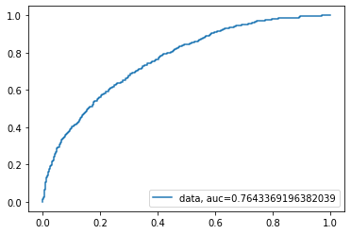
Evaluating Logistic Regression
AREA UNDER CURVE - CONCEPT
AUC means Area Under Curve where you can calculate the area under various curves.
The AUC value can be used as an evaluation metric, especially when there is imbalanced dataset.
CONCLUSION
The AUC for Logistic Regression is calculated at 76.43%

Slide 37
Random Forest

Slide 38

Evaluating Random Forest
RANDOM FOREST - CONCEPT
Random forest, like its name implies, consists of a large number of individual decision trees that operate as an ensemble. Each individual tree in the random forest spits out a class prediction and the class with the most votes becomes our model’s prediction.
CONFUSION MATRIX - CONCEPT
A confusion matrix is a technique for summarizing the performance of a classification algorithm.
Calculating a confusion matrix can give you a better idea of what your classification model is getting right and what types of errors it is making.
CONCLUSION
The confusion matrix on the left gives us the numeric breakdown of all true/false positive/negatives in the testing data.

Slide 39
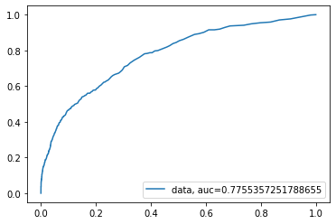
Evaluating Random Forest
AREA UNDER CURVE - CONCEPT
AUC means Area Under Curve where you can calculate the area under various curves.
The AUC value can be used as an evaluation metric, especially when there is imbalanced dataset.
The AUC for decision tree is calculated at 77.55%
CONCLUSION
The AUC for decision tree is calculated at 77.55%

Slide 40
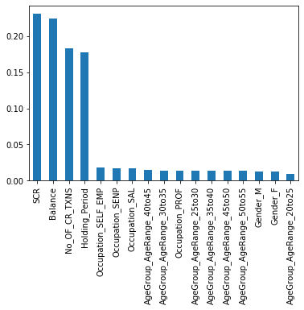
Feature Importance - Random Forest
FEAUTURE IMPORTANCE - CONCEPT
Feature importance refers to techniques that assign a score to input features and also play an important role in a predictive modeling project, including providing insight into the data and the model, and the basis for feature selection that can improve the efficiency and effectiveness of a predictive model on the business problem.
CONCLUSION
The most important features (Top 5) as shown on left are:
SCR
Balance
No. of credit transactions
Holding Period
Occupation – SELF EMP

Slide 41
K-Nearest Neighbors

Slide 42
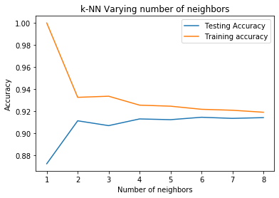
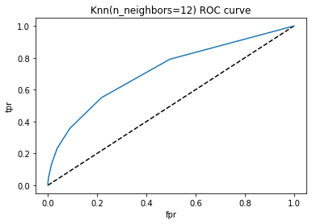
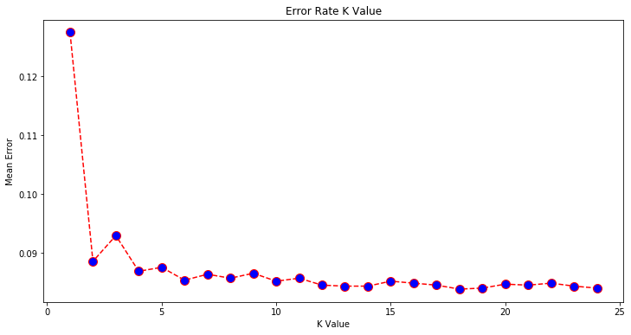
KNN
C
CONCEPT - KNN
The KNN algorithm assumes that similar things exist in close proximity. In other words, similar things are near to each other.
As shown in the graphs on the left, the best value of n_neighbor is 20 with 91.38%

Slide 43
Support Vector Machine

Slide 44
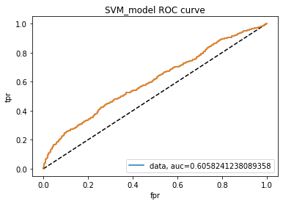
SVM
AREA UNDER CURVE - CONCEPT
AUC means Area Under Curve where you can calculate the area under various curves.
The AUC value can be used as an evaluation metric, especially when there is imbalanced dataset.
CONCLUSION
The AUC for SVM is calculated at 60.58%

Slide 45
CatBoost

Slide 46
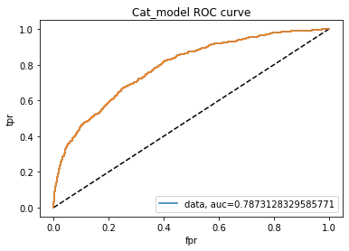
CatBoost
AREA UNDER CURVE - CONCEPT
AUC means Area Under Curve where you can calculate the area under various curves.
The AUC value can be used as an evaluation metric, especially when there is imbalanced dataset.
CONCLUSION
The AUC for CatBoost is calculated at 78.73%

Slide 47
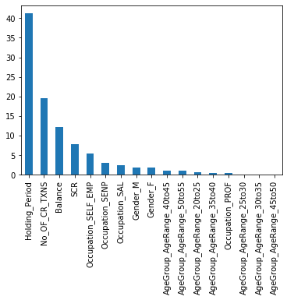
CatBoost
FEATURE IMPORTANCE - CONCEPT
Feature importance refers to techniques that assign a score to input features and also play an important role in a predictive modeling project, including providing insight into the data and the model, and the basis for feature selection that can improve the efficiency and effectiveness of a predictive model on the business problem.
CONCLUSION
The most important features (Top 5) as shown on left are:
Holding Period
No. of credit transactions
Balance
SCR
Occupation – SELF EMP

Slide 48
Comparing Models

Slide 49
Comparison
Model | Accuracy | AUC | Recall | Prec. | F1 | Kappa | MCC | TT (Sec)
CatBoost Classifier | 0.9206 | 0.7964 | 0.1463 | 0.6508 | 0.2380 | 0.2138 | 0.2824 | 9.235
Random Forest Classifier | 0.9196 | 0.7801 | 0.1184 | 0.6668 | 0.2005 | 0.1793 | 0.2573 | 1.437
Logistic Regression | 0.9150 | 0.7099 | 0.0102 | 0.3167 | 0.0196 | 0.0169 | 0.0492 | 0.267
K Neighbors Classifier | 0.9062 | 0.6274 | 0.0508 | 0.2511 | 0.0839 | 0.0572 | 0.0783 | 0.160
SVM - Linear Kernel | 0.8942 | 0.0000 | 0.0625 | 0.1838 | 0.0810 | 0.0442 | 0.0547 | 0.120
Decision Tree Classifier | 0.8602 | 0.5822 | 0.2470 | 0.2176 | 0.2311 | 0.1547 | 0.1551 | 0.074
No Ransom Effect

Slide 50
Conclusion
CONCLUSION
Random Forest model has been finalized because of following reasons:
Model is good with accuracy 91.98% (~92%) and precision 67%
AUC is 77.55% (~78%)
FP=31 which is less. It states that the actual value=0, but predicted value=1. This should be less because if it would have been in larger proportion, then the cost of approaching those customers would have got wasted.
The feature importance is also in line with logistic regression
Therefore, LIME and SHAP have been performed on the random forest model.
Logistic regression has been used to identify different segments (profitable segment).

Slide 51
Local Interpretable Model-agnostic Explanations

Slide 52
LIME
Local Interpretable Model-agnostic Explanations - CONCEPT
LIME is a technique which explains the prediction of any classifier in an interpretable manner by learning an interpretable model locally around the prediction. Each part of the name reflects something that we desire in explanations:
This explanation is useless unless it is interpretable - that is, unless a human can make sense of it
Lime is able to explain any model without needing to 'peak' into it, so it is model-agnostic
Local refers to local fidelity - i.e., we want the explanation to really reflect the behavior of the classifier around the instance being predicted
I
M
It explains predictions for a black-box approach
L
E

Slide 53
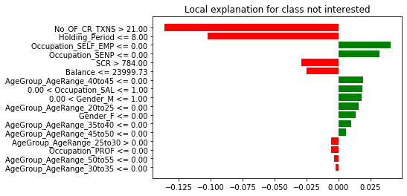
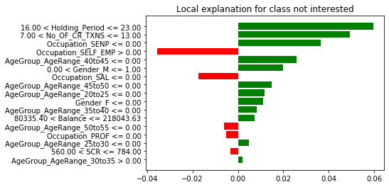
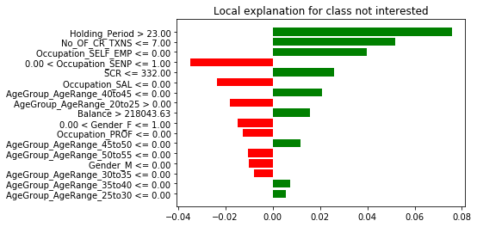
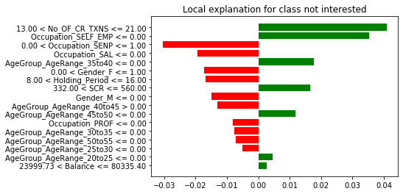
LIME
C

Slide 54
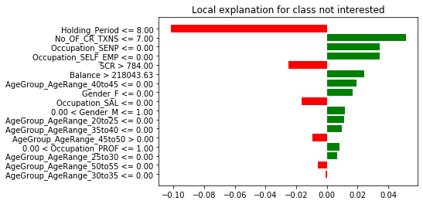
LIME
CONCLUSION
It can be seen from the output of SP – LIME, following variables are effecting the most:
Holding Period
No. of credit transactions
Occupation – SAL
SCR
Occupation – SELF EMP
Balance

Slide 55
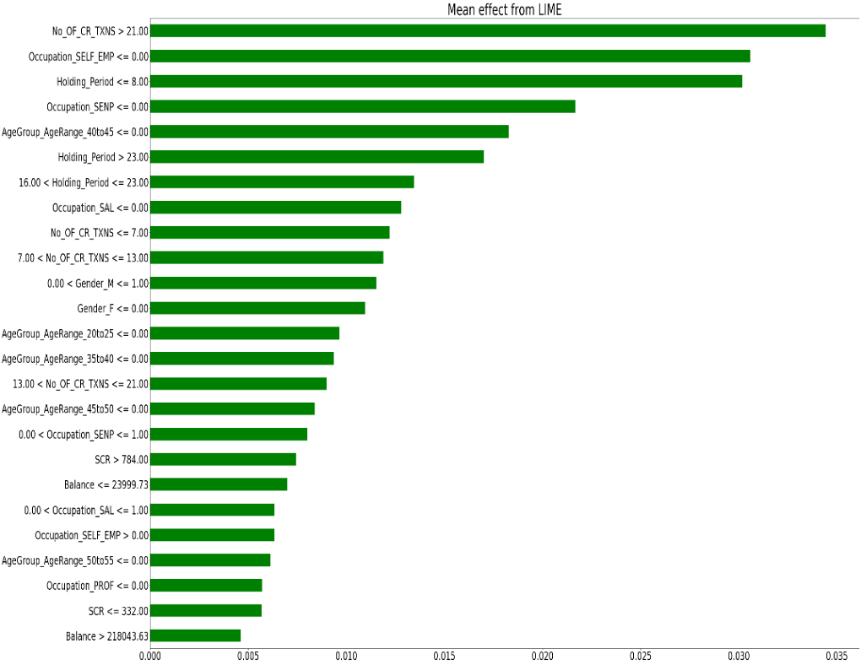
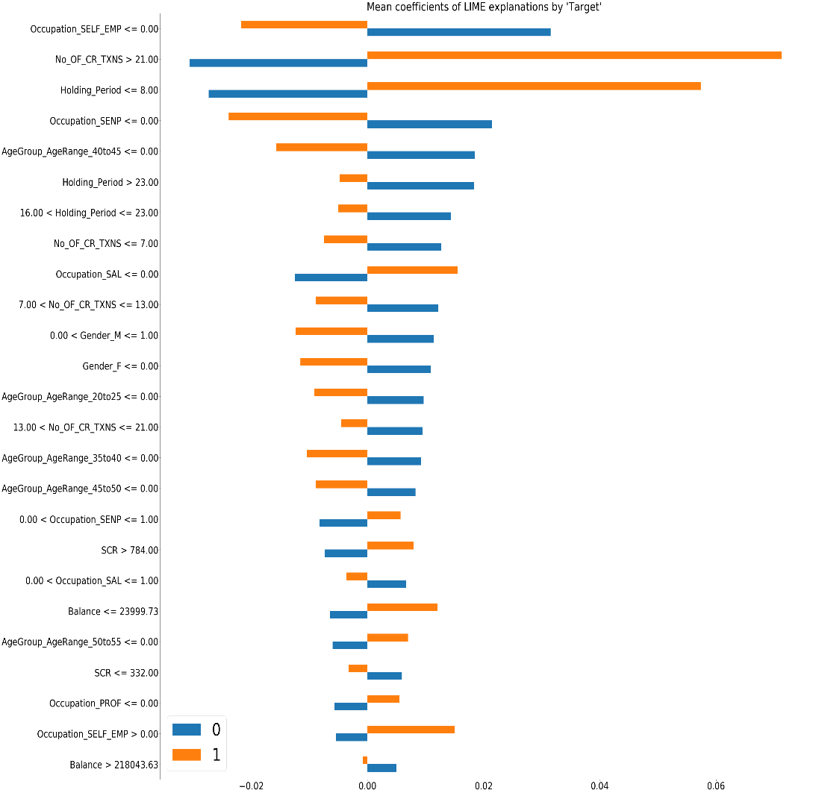
LIME
C
CONCLUSION
The first plot on the left shows the mean effect of each variable from LIME
The second plot on the right shows mean coefficients of LIME explanations by ‘Target’

Slide 56
Shapley Additive exPlanations

Slide 57
SHAP
SHAPLEY ADDITIVE EXPLANATIONS - CONCEPT
SHAP is a method to explain individual predictions. It quantifies the contribution that each variable brings to the prediction made by the model.
Shapley values tell us how to fairly distribute the prediction among the features.
FEATURE IMPORTANCE
The idea behind SHAP feature importance: Features with large absolute Shapley values are important. Since we want the global importance, we average the absolute Shapley values per feature across the data.
SHAP feature importance is an alternative to permutation feature importance. There is a big difference between both importance measures: Permutation feature importance is based on the decrease in model performance. SHAP is based on magnitude of feature attributions

Slide 58
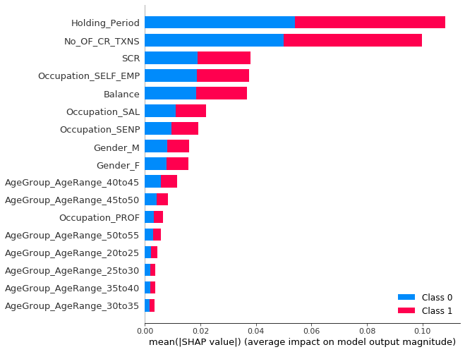
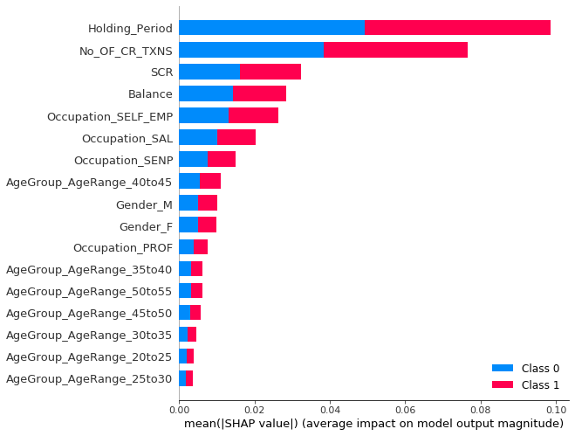
SHAP
C
SHAP – SUMMARY PLOT
Based on the SHAP summary plot, we can see top 11 features and their indications of the relationship between the value of a feature and the impact on the classification model. For better understanding let us have a look at the dependence plots.

Slide 59
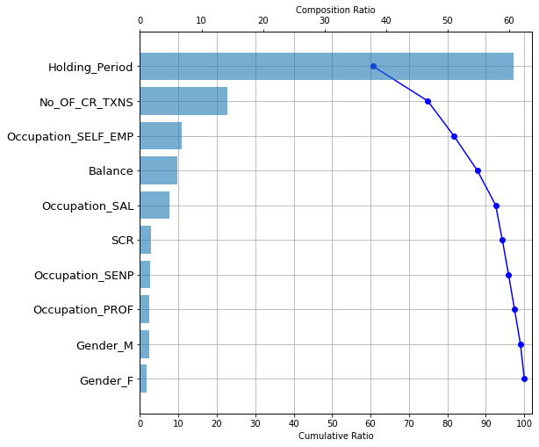
SHAP
C
SHAP FORCE PLOT
The plot consists of many force plots, each of which explains the prediction of an instance. We rotate the force plots vertically and place them side by side according to their clustering similarity.
Red SHAP values increase the prediction, blue values decrease it.
SHAP WATERFALL PLOT
Based on the SHAP waterfall plot, we can say that ‘Holding Period’ is the most important feature in the model, which has more than 60% of the model's explainability.
Also, these top 11 features provide 100% of the model's interpretation.

Slide 60
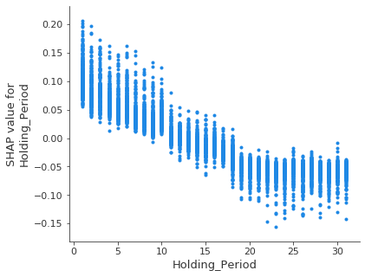
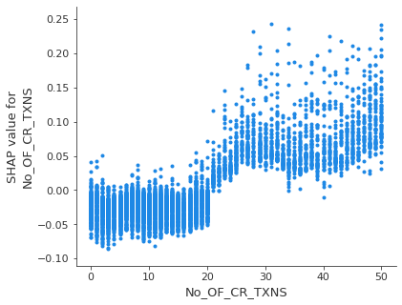
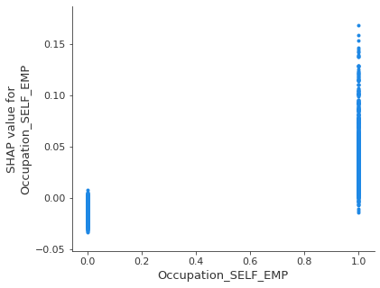
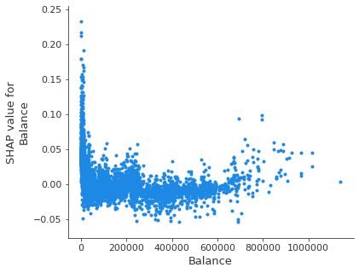
Top Features and Dependence Plots - SHAP
CONCLUSION
Based on the SHAP dependence plots, it is clear that customers, who are interested to take loan tend to have the following features:
Holding Period<=10
No. of credit transactions >20
Occupation - SELF_EMP=1
Balance between 0 to 50000
On the other hand, customers, who are not interested to take loan may have the following features:
Holding Period>10
No. of credit transactions <20
Occupation - SELF_EMP=0
Balance > 50000
C

Slide 61
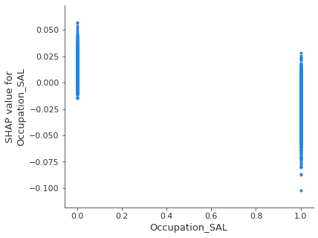
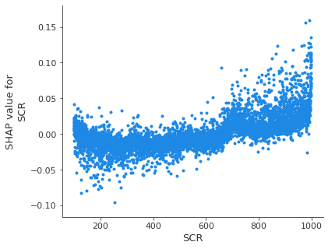
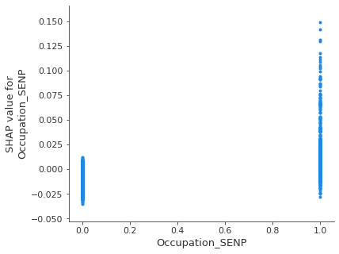
Top Features and Dependence Plots - SHAP
C
CONCLUSION
Based on the SHAP dependence plots, it is clear that customers, who are interested to take loan tend to have the following features:
Occupation - SAL=0
SCR>600
Occupation - SENP=1
On the other hand, customers, who are not interested to take loan may have the following features:
Occupation - SAL=1
SCR<600
Occupation - SENP=0

Slide 62
Permutation Feature Importance

Slide 63
Permutation Feature Importance
Weight | Features
0.0129 ± 0.0047 | No. of credit transactions
0.0047 ± 0.0015 | Holding Period
0.0045 ± 0.0008 | Balance
0.0039 ± 0.0033 | SCR
0.0031 ± 0.0015 | Occupation – SELF EMP
0.0012 ± 0.0005 | Occupation – SENP
0.0006 ± 0.0007 | AgeGroup_AgeRange_50to55
0.0006 ± 0.0003 | AgeGroup_AgeRange_40to45
0.0006 ± 0.0011 | Occupation_PROF
0.0005 ± 0.0004 | AgeGroup_AgeRange_25to30
0.0005 ± 0.0003 | AgeGroup_AgeRange_35to40
0.0004 ± 0.0009 | Occupation_SAL
0.0004 ± 0.0005 | AgeGroup_AgeRange_30to35
0.0000 ± 0.0006 | AgeGroup_AgeRange_20to25
0.0000 ± 0.0004 | Gender_M
-0.0004 ± 0.0003 | AgeGroup_AgeRange_45to50
-0.0004 ± 0.0008 | Gender_F
CONCLUSION
The values towards the top are the most important features, and those towards the bottom matter least.
In the ‘Weight’ column, the number in each row before + sign shows how much model performance decreased with a random shuffling (in this case, using "accuracy" as the performance metric). The number after the ± sign measures how performance varied from one-reshuffling to the next.
We have measured the amount of randomness in our permutation importance calculation by repeating the process with multiple shuffles.
Occasionally, negative values for permutation importance can be seen. In those cases, the predictions on the shuffled (or noisy) data happened to be more accurate than the real data. This happens when the feature didn't matter, but random chance caused the predictions on shuffled data to be more accurate.

Slide 64
Identification of profitable segment to do customized marketing
50
10
100
Sales
50
10
100
Marketing Efforts

Slide 65
Kolmogorov-Smirnov (KS)
Decile | Defaulter_Count | Non-Defaulter_Count | max_score | min_score | Total_Cust | Default_Rate | Default % | Non_Default % | ks_stats | max_ks
10 | 169 | 425 | 0.660487 | 0.197641 | 594 | 28.45% | 35.65% | 7.78% | 27.88
9 | 74 | 520 | 0.197504 | 0.136445 | 594 | 12.46% | 15.61% | 9.52% | 33.97
8 | 60 | 534 | 0.136389 | 0.098941 | 594 | 10.10% | 12.66% | 9.77% | 36.86
7 | 50 | 544 | 0.098872 | 0.074847 | 594 | 8.42% | 10.55% | 9.95% | 37.46 | *****
6 | 38 | 555 | 0.074829 | 0.056574 | 593 | 6.41% | 8.02% | 10.16% | 35.32
5 | 32 | 562 | 0.056463 | 0.042491 | 594 | 5.39% | 6.75% | 10.28% | 31.78
4 | 26 | 568 | 0.042466 | 0.031011 | 594 | 4.38% | 5.49% | 10.39% | 26.88
3 | 13 | 581 | 0.030995 | 0.021918 | 594 | 2.19% | 2.74% | 10.63% | 18.99
2 | 8 | 586 | 0.021917 | 0.014608 | 594 | 1.35% | 1.69% | 10.72% | 9.95
1 | 4 | 590 | 0.014595 | 0.003749 | 594 | 0.67% | 0.84% | 10.80% | 0.00
KS - CONCEPT
It is one of the most important metrics used for validating predictive models.
In data science, it compares the cumulative distribution of events and non-events and KS is where there is a maximum difference between the two distributions. In simple words, it helps us to understand how well our predictive model is able to discriminate between events and non-events.

Slide 66
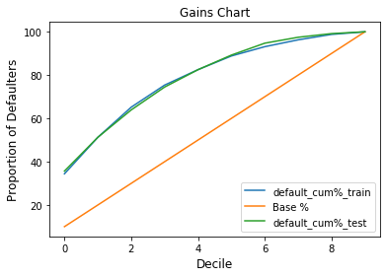
Gain Chart
Decile | default_cum%_train | Base % | default_cum%_test
10 | 34.41 | 10 | 35.65
9 | 51.26 | 20 | 51.27
8 | 65.18 | 30 | 63.92
7 | 75.38 | 40 | 74.47
6 | 82.51 | 50 | 82.49
5 | 88.83 | 60 | 89.24
4 | 93.12 | 70 | 94.73
3 | 96.28 | 80 | 97.47
2 | 98.79 | 90 | 99.16
1 | 100.00 | 100 | 100.00
GAIN CHART - CONCEPT
It conveys really useful information with actual business insights upon which informed decisions can be made to cut-down costs while maximizing the utility of our predictive model

Slide 67
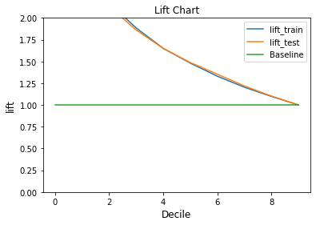
Lift Chart
Decile | lift_train | lift_test | Baseline
10 | 3.441000 | 3.565000 | 1
9 | 2.563000 | 2.563500 | 1
8 | 2.172667 | 2.130667 | 1
7 | 1.884500 | 1.861750 | 1
6 | 1.650200 | 1.649800 | 1
5 | 1.480500 | 1.487333 | 1
4 | 1.330286 | 1.353286 | 1
3 | 1.203500 | 1.218375 | 1
2 | 1.097667 | 1.101778 | 1
1 | 1.000000 | 1.000000 | 1
LIFT CHART - CONCEPT
The Lift curve is the last chart that completes our analysis of our binary classification model’s performance.
The customers whose probability distribution is falling between the range between 0.074847 to 0.660487 are the profitable segment for the bank

Slide 68
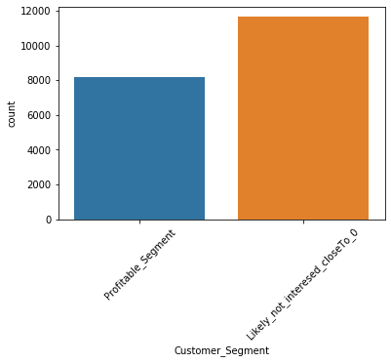
Customer Segment
The attached sheet can be used by the Bank to find the profitable segment so that more customized marketing can be done
CONCLUSION
8,161 customers are falling under the segment of 'Profitable Segment’ for targeting. They are those customers whose probability is between 0.074847 to 0.660487. They can be considered as profitable segment for customized marketing by minimizing the cost.
Percentage of customers falling under profitable segment for customized marketing by minimizing the cost = 41.22%

Slide 69
Automating Machine Learning

Slide 70
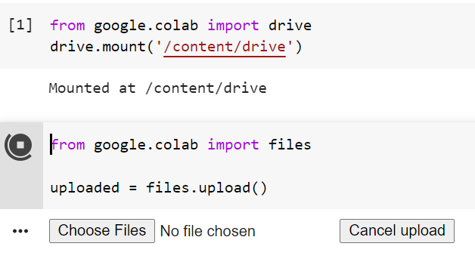
AutoVIML
SUN | MON | TUE | WED | THU | FRI | SAT
 |  |  |  | 1 | 2 | 3
4 | 5 | 6 | 7 | 8 | 9 | 10
11 | 12 | 13 | 14 | 15 | 16 | 17
18 | 19 | 20 | 21 | 22 | 23 | 24
25 | 26 | 27 | 28 | 29 | 30 | 31
Model will be needed on a monthly basis as this data gets updated each month

Slide 71
THANK YOU
50
10
100
Sales
50
10
100
Marketing Efforts

